Slide 1


Presentation on
Generation of AM wave
Using matlab
(square wave as modulating signal)
Submitted by: Vikash Kumar
Guided by: Mr. Irfanul Hasan
And
Ms. Gitanjali Manocha

Slide 2
Presentation outline:
Introduction
Motivation
Methodology
Present works
Conclusions
References

Slide 3
Introduction
Amplitude modulation is a process in which amplitude of the carrier wave is varied in accordance with the instantaneous values of the modulating signal.
It can also be defined as the process in which the amplitude of the carrier wave is varied about the mean value, linearly with the modulating signal.
i.e. v=v+k*m(t) , where k is the proportionality constant.
If the modulating signal, m(t)=vm*square(2*pi*fm*t)
And carrier signal, c(t)=vc*cos(2*pi*fc*t)
Then the modulated signal will be, s(t)=vc[1+ka*m(t)]*cos(2*pi*fc*t)

Slide 4
Introduction continued…
The original signal can be reconstructed by using the coherent detector at the receiver end.
It is said to be coherent detector because the frequency and phase of locally generated carrier signal in a synchronous(coherent) is same as that of transmitted carrier signal.

Slide 5
Motivation
More Efficient Use of Bandwidth/Spectrum
Reduced Antenna Size at High Frequency
 Antenna Size is a Function of Wavelength
Wavelength is Inversely Proportional to Frequency
Transmission of Baseband Signals over Broadband Media.
Above facts are the prime motivation for this project work.

Slide 6
Methodology
Writing MATLAB code for generation of amplitude modulation.
Plotting waveform of message signal(square wave),carrier signal, and AM wave.
Modulation and demodulation of message signal through MATLAB Simulink.

Slide 7
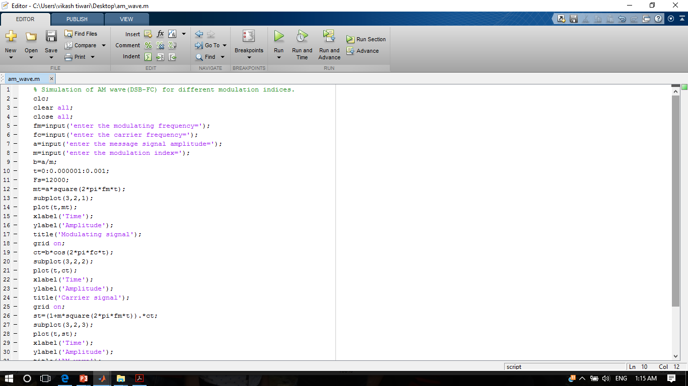

Slide 8
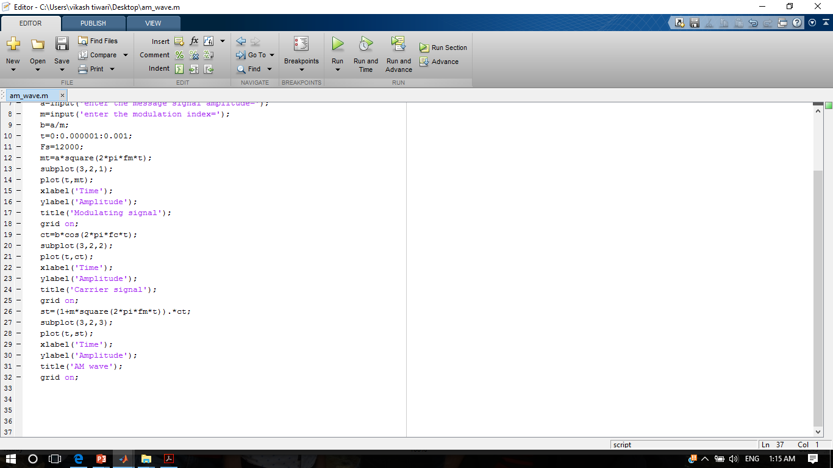

Slide 9
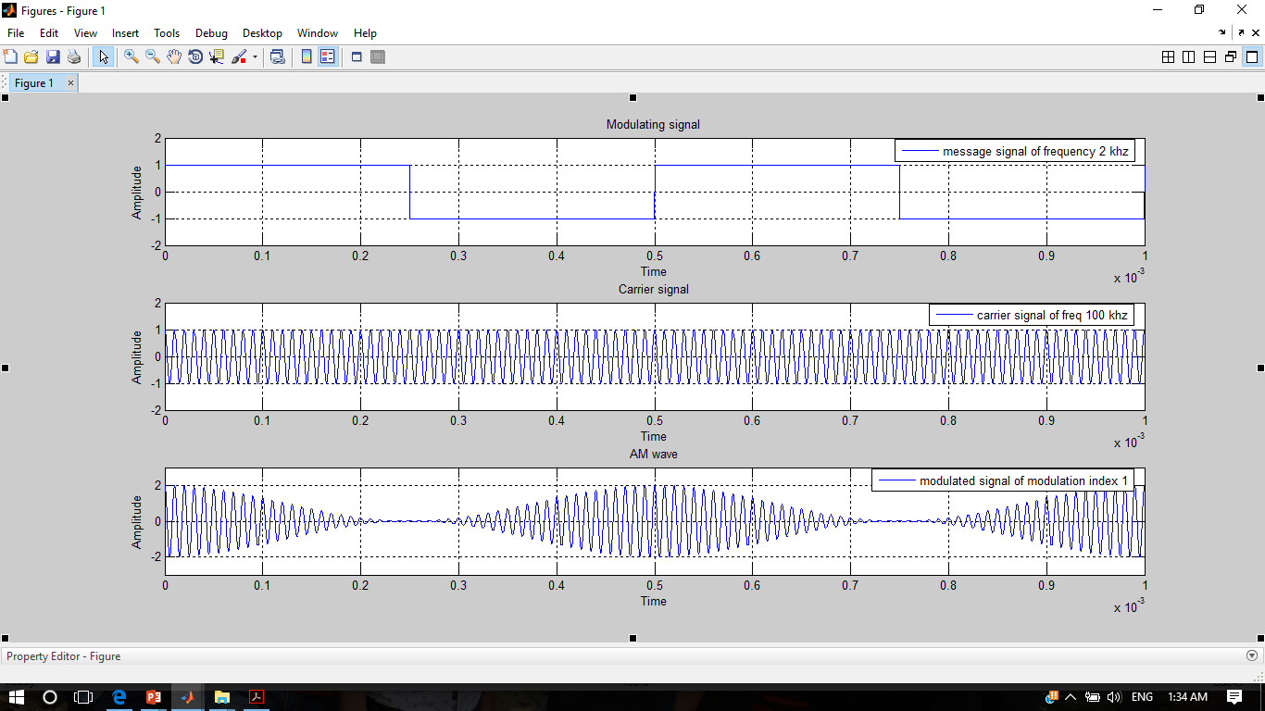

Slide 10
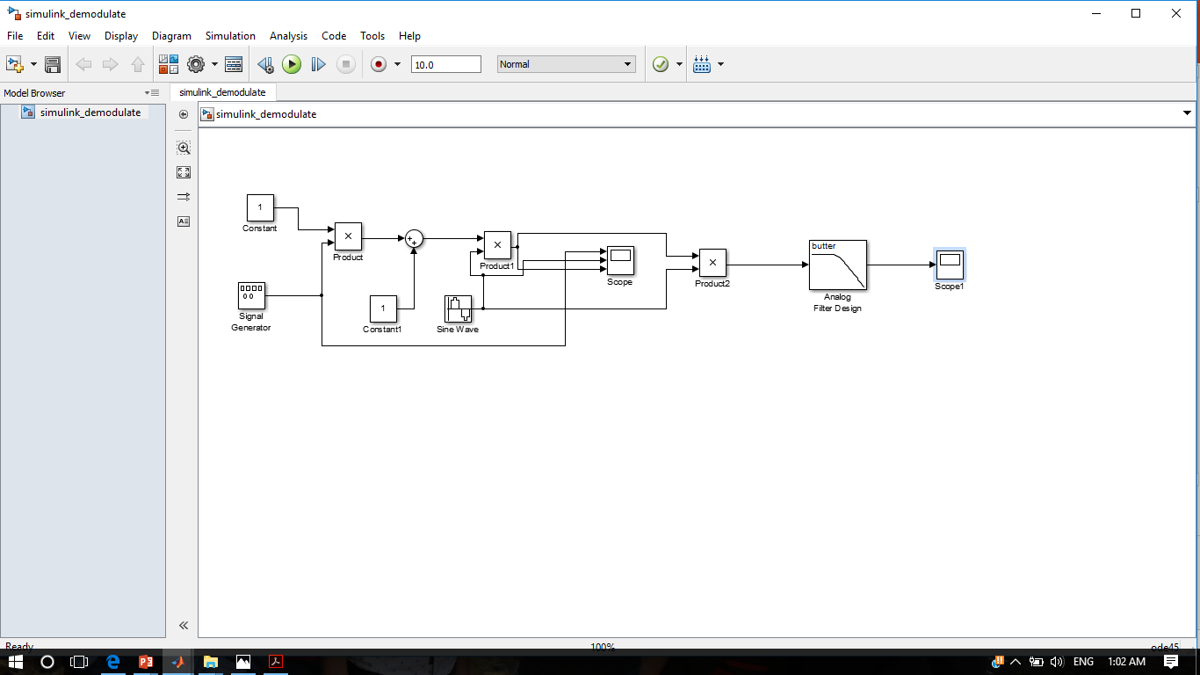

Slide 11
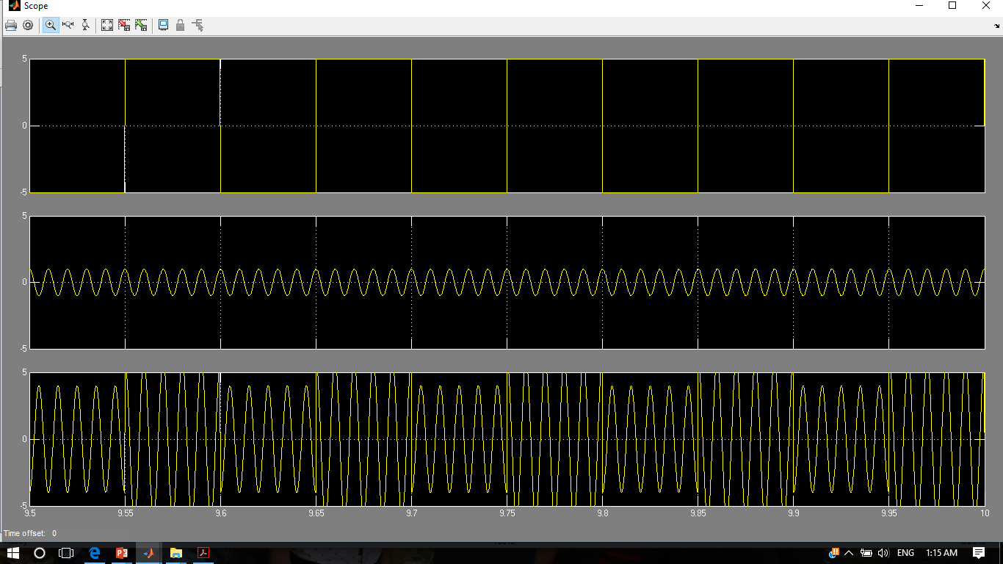

Slide 12
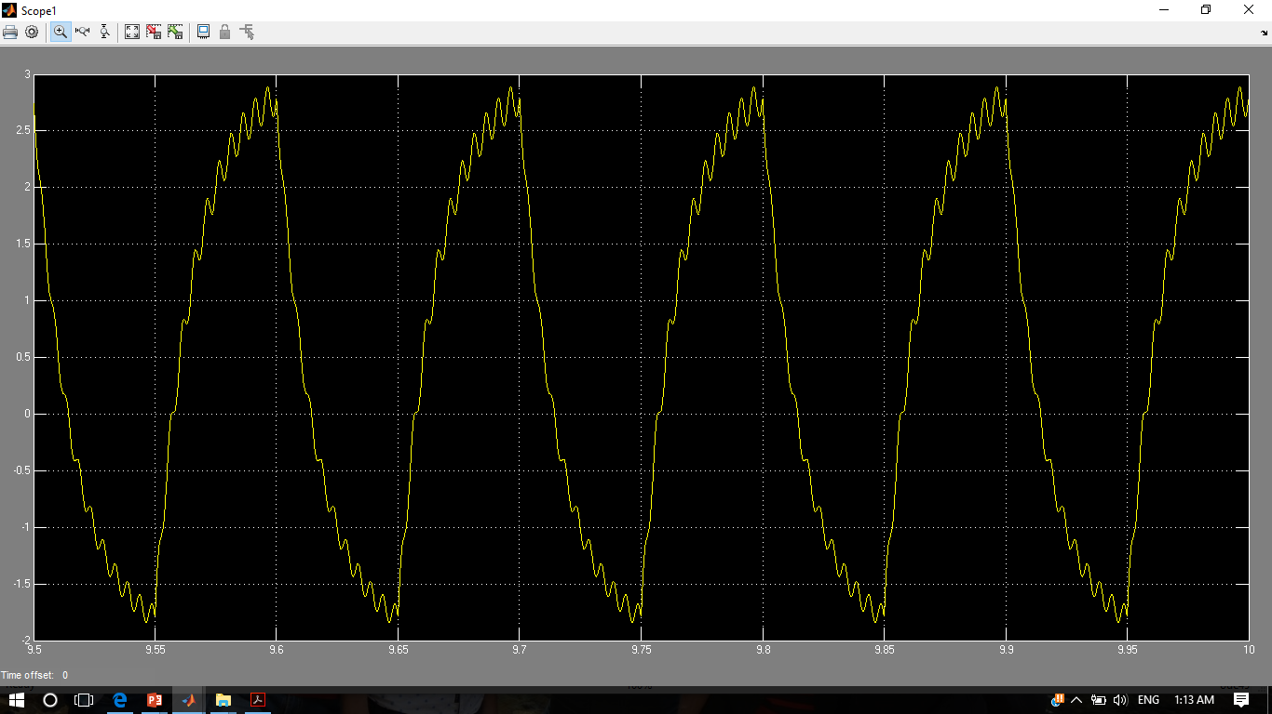

Slide 13
Conclusions
A square wave is produced by the sum of many sine wave harmonics of that particular frequency with diminishing Amplitude .
for ex:
Consider we need to generate a square wave of 50 hz:
1V of Square Wave of 50 Hz = 1Volt of Sine wave of 50 Hz + 1/3 volt of Sine wave of 150 hz + 1/5 volt of Sine wave of 250 hz + 1/7 volt of Sine wave of 350 hz +............................................... upto infinity.

Slide 14
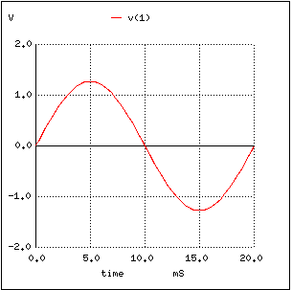
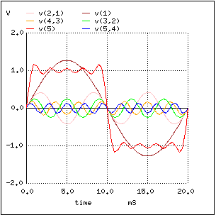
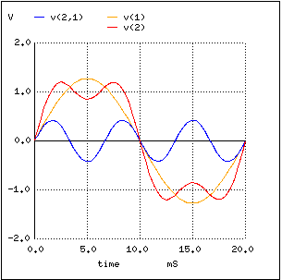
50 Hz 50Hz+150Hz 50Hz+150Hz+250Hz

Slide 15
Conclusions contd…
Modulating signal(square wave) is being modulated easily through MATLAB
but demodulation of modulated signal is being difficult because square wave
has many harmonics of sine wave… hence distorted sinusoidal signal is
obtained at the output of coherent detector.

Slide 16
References
MATLAB help.
https://in.mathworks.com/
Class notes.

